Slide 1
Australian Province
Education Ministry 2018

Slide 2
Education ministry structure

Slide 3
Jesuit and Companion schools Australia (JACSA)
5 Jesuit owned schools:
Xavier College, Melbourne 1878
St Aloysius’ College, Sydney 1879
Saint Ignatius’ College, Riverview (Sydney) 1880
Saint Ignatius’ College, Adelaide 1951 (Co-educational)
Redfern Jarjum College, Sydney 2013 – Primary school to help Indigenous students transition to mainstream education
6 Jesuit Companion Schools (all co-educational)
John XXIII College, Perth (K-12)
Loyola Senior High School, Mt Druitt- Sydney (Years 11-12)
Loyola College, Watsonia –Melbourne (7-12)
Saint Ignatius’ College, Geelong (7-12)
Xavier Catholic College, Hervey Bay (K-12)
Xavier Catholic College, Ballina (7-12)

Slide 4
Jesuit owned schools

Slide 5
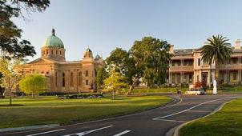
Xavier college, Melbourne -1878
3 campuses
Two campuses – 3 year old to Year 4 co-ed and Year 5-8 boys only
Senior Campus –boys only Years 9-12. 60 boarding students
1950 students including 35 girls – 87.8% Catholics
349 staff including 1 Jesuit
New principal this year

Slide 6



Slide 7
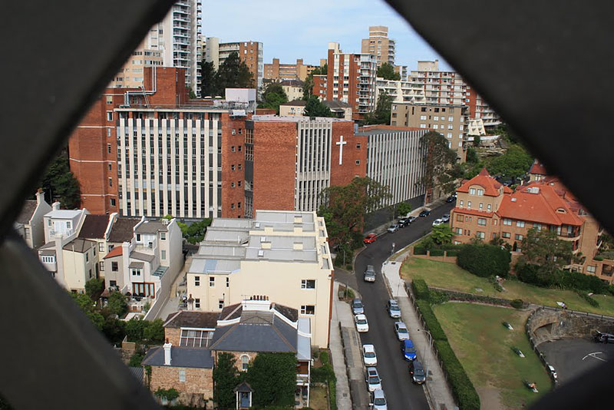
St Aloysius’ college, sydney 1879
Two campuses – Years 3-6, Years 7-12
Boys only
1253 students – 95 % Catholic
185 staff including 2 Jesuits
New Rector this year

Slide 8



Slide 9
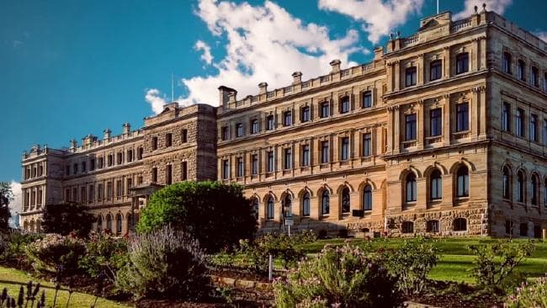
Saint Ignatius’ college, riverview, Sydney 1880
Years 5-12
Boys only
1583 students – 96% Catholic,
330 Boarding students including 30-40 indigenous students
296 staff including 3 Jesuits
New Rector this year

Slide 10
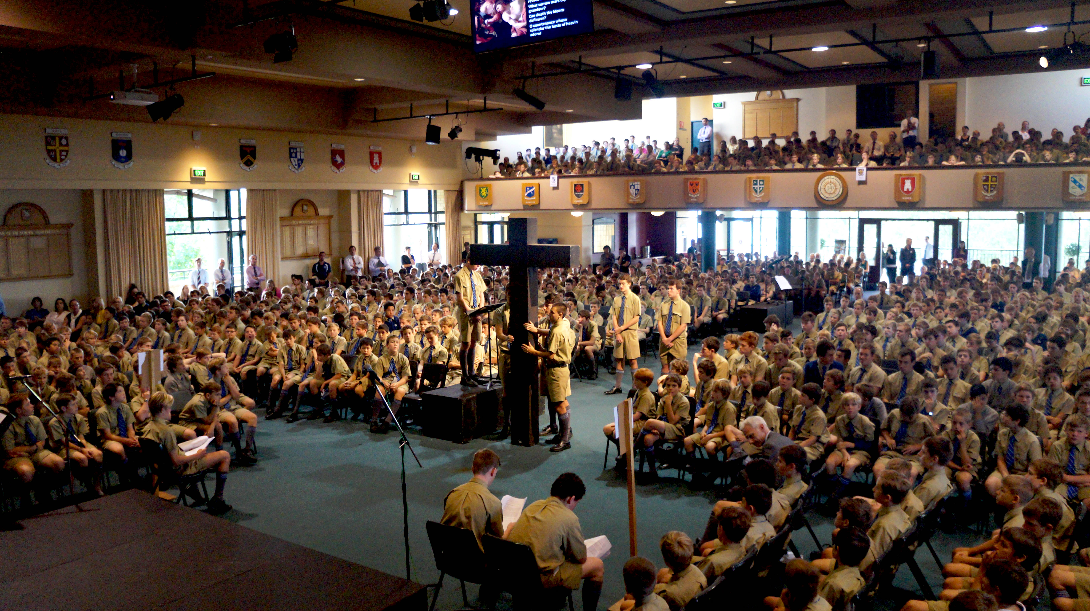
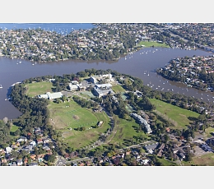

Slide 11
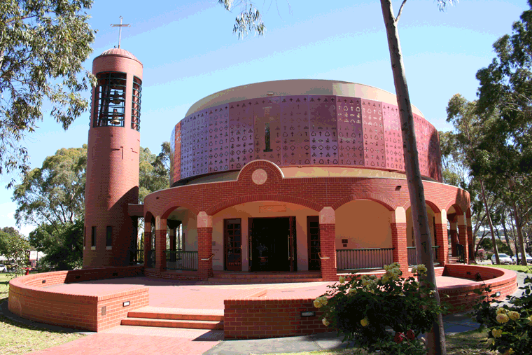
Saint Ignatius’ college, Adelaide 1951
Two campuses –3 year old- Year 6, Years 7-12
Co-educational
1385 students – 73 % Catholic
198 staff including 2 Jesuits
New Principal and Rector this year

Slide 12



Slide 13
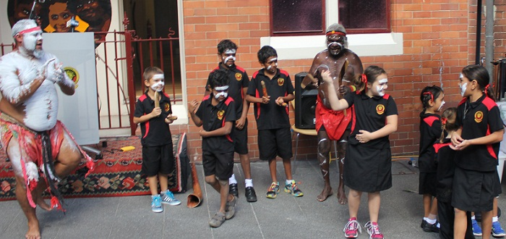
Redfern jarjum college, Sydney 2013
Offers education to First Nations/Indigenous students whohave fallen outside mainstream schools
Coeducational
16 students – 0% Catholic
8 staff
Recruiting for a new Principal

Slide 14
Jesuit companion schools

Slide 15
The Province has no legal or financial responsibility or governance oversight of these schools.
The Province, through Jesuit Education Australia, seeks to help them embed the Ignatian ethos and charism within the school, especially in their faith formation offering and through the use of the IPP to support curriculum. They appoint a member of staff as their Ignatian Co-Ordinator.
Together with the Jesuit owned schools they belong to the JACSA network – Principals and Rectors meet 3 times a year, Ignatian Co-ordinators and other professional learning communities
Students of JACSA participate in sporting carnivals, senior student leaders conference and a joint immersion to Timor Leste
Ignatian pilgrimages for selected staff of JACSA to Europe and Asia – following the footsteps of Ignatius and Francis Xavier

Slide 16
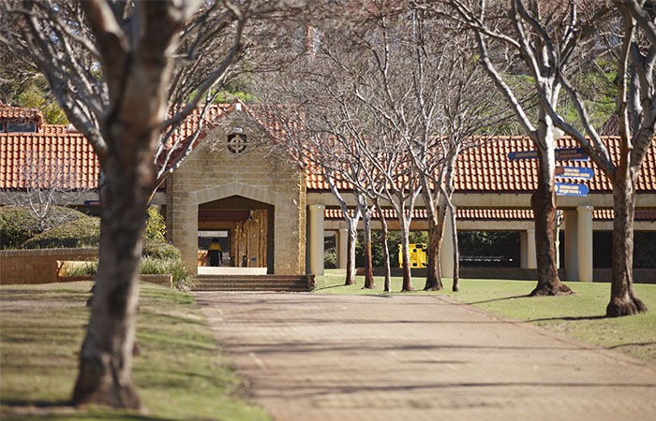
John XXIII College, perth 1977
Amalgamation of St Louis School (Jesuit Boys) and Loreto Girls Nedlands
Co education, K-Year 12
1539 students – 81% Catholic
241 Staff
Independent Catholic school, Jesuit Provincial representative on Governing Council

Slide 17
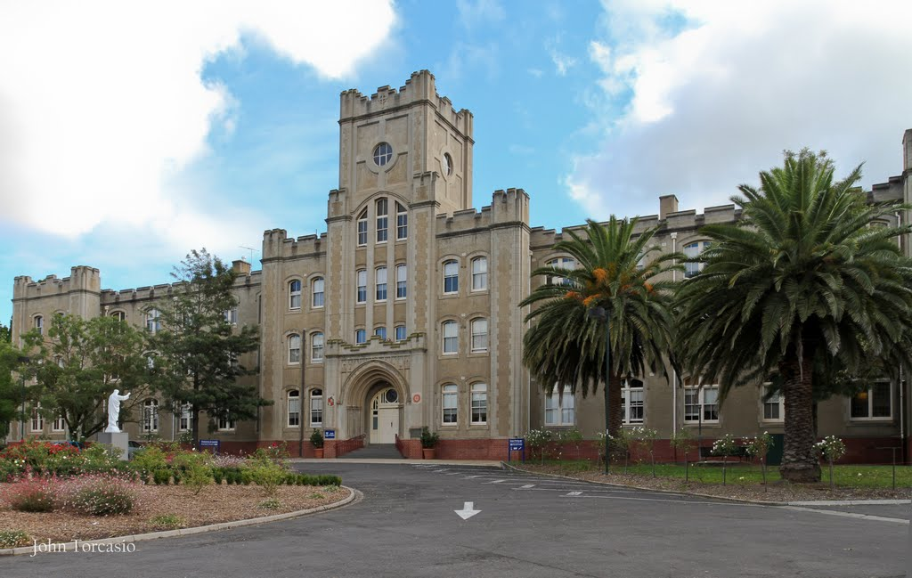
Loyola college, watsonia, Melbourne 1980
Years 7-12, Co-education
1341 students – 77% Catholic
160 staff
Diocesan school governed by 6 Canonical administrators – parish priests of 6 parishes in the area.

Slide 18

Loyola senior high school, mount druitt, western Sydney 1993
Co-education
Years 11 and 12 – Mainstream education and trade training centre.
534 students – 54% Catholic
75 staff
Significant changes 2019 onwards – focus on trade training centre
Catholic Diocesan school

Slide 19
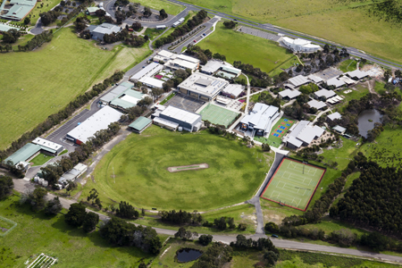
Saint Ignatius college, geelong
1991 – Jesuit affiliation 2007
Co-educational, years 7-12
1279 students – 65% Catholic
134 staff
Diocesan school – canonical adminstrators – owned by 4 parishes – Jesuit Provinical representative on the governing board

Slide 20

Xavier catholic college, hervey bay, 2002 , jesuit affiliation 2009
Co-educational, P- Year 12
1067 students- 58% Catholic
134 staff
Diocesan owned and governed school

Slide 21

Xavier catholic college, ballina
2000, jesuit affiliation 2016
Co-education, Years 7-12
912 students, 58% Catholic
116 Staff
Diocesan owned and governed school.

Slide 22
Incorporation – jesuit schools
Change in governance arrangements with each Jesuit school becoming incorporated.
Each company owned by Jesuit Education Australia which in turn is owned by the Province
Sydney and Melbourne schools have transitioned to new model with no issues.
Adelaide will transition in July 2017

Slide 23
Property ownership remains with the Province and leased to the new incorporated entities for 99 years
Local boards have responsibility for employing all staff and managing and governing the school.
Director and principal appointments, annual budget, strategic plans and master plans approval comes from Jesuit Education Australia (JEA). JEA must seek prior approval of Provincial.
Interaction with government regulatory authorities

Slide 24
Increased focus on formation of board directors and senior leaders within schools – working on formation framework
Increased government oversight and compliance obligations
Financial Restrictions relating to government funding and tuition revenue
Ongoing uncertainty regarding government funding

Slide 25
Professional standards
5 year Royal Commission into sexual abuse of children in institutions including Catholic schools and parishes
17 volume report – 189 specific recommendations – 21 specific to the Catholic Church, 8 to all schools, 28 to al religious institutions, also some relating to retention of records
Significant obligations on Principals and the Province with respect to reporting allegations of abuse

Slide 26
Province has engaged the Australian Childhood Foundation to audit our policies and practices in every ministry
New Province Code of Conduct to be launched in the coming weeks
As part of the incorporation process, the Province has accepted financial and legal responsibility for historic claims of abuse as well as any future claims of abuse after the new structure.
Strong focus on governance, risk and compliance

Slide 27
Master plans/strategic plans
A number of the schools have ambitious master plans over the next 20 years.
Working with them facilitating approval from JEA, Province and Rome – stressing the importance of following the IAG.
Schools also working on new strategic plans
Province also working on new Apostolic Plan

Slide 28
Other issues
New governance structures – a “learning year” for all of us
Significant changes in leadership in each of the Jesuit owned schools
Redfern Jarjum College – search for a new Principal
Reviewing and updating the arrangements with Jesuit Companion schools
Proposed changes at Loyola Senior High School, Mt Druitt

