Slide 1
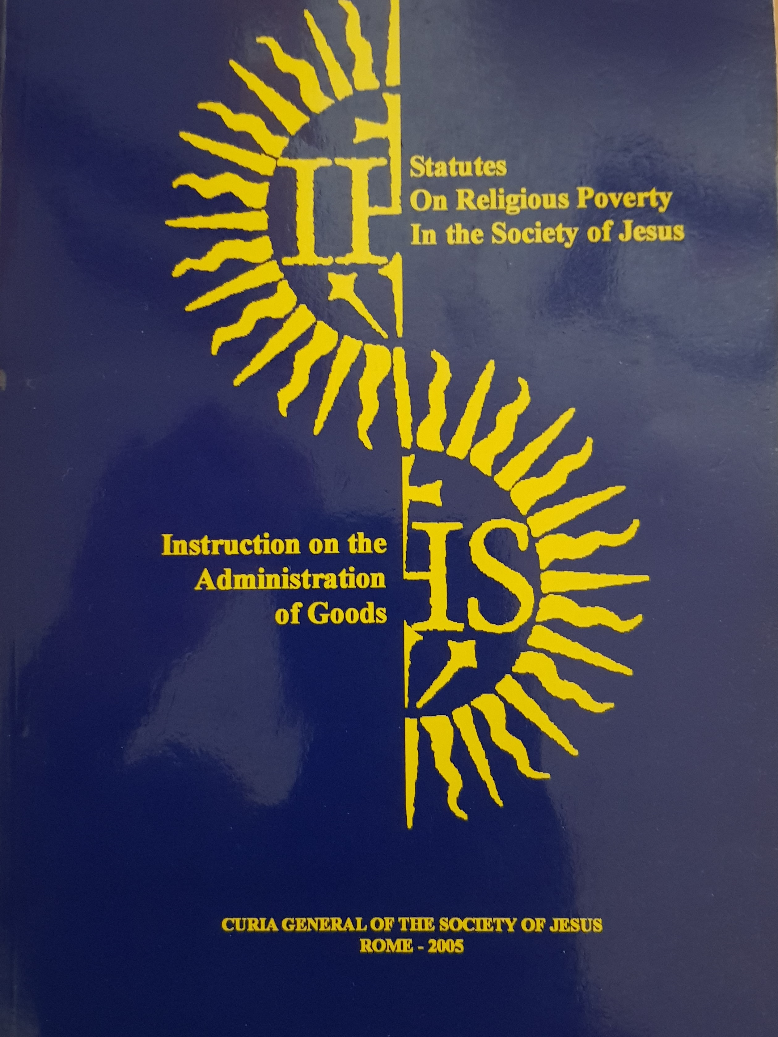
Australian Province of the Society of Jesus
Statute On Religious Poverty In the Society of Jesus
Instruction on
the Administration Of Goods
27 October 2017

Slide 2
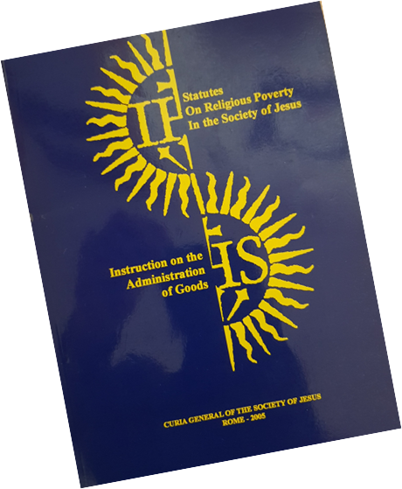
Two Main Components
Spiritual foundations - Statues on Religious Poverty in the Society of Jesus
Instructions on the Administration oF Goods
2
Australian Province of the Society of Jesus

Slide 3
Statues on Religious Poverty in the Society of Jesus
General principles
Personal poverty
Poverty in common
The yielding of administration and the disposition and renunciation of property
3
Australian Province of the Society of Jesus

Slide 4
Instructions on the Administration of Goods
Instructions on the Administration of Goods
Nature and Objectives
Legal Aspects and the Basics Of Financial Administration
Financial Administration at the level of the General
Financial Administration at the Province Level
Financial Administration at the Local Level
Main Functions of Financial Administration and The Practical Way of Proceeding in Various Matters
Reporting (External and internal)
4
Australian Province of the Society of Jesus

Slide 5
Australian Province of the Society of Jesus
Understanding the Instruction on
the Administration of Goods
“IAG”
27 October 2017

Slide 6
Understanding the IAG The Nature of the Instruction “IAG”
The “Instruction” IAG is a combination of rules, regulations, advices and notes to help in the appropriate management of the goods of the Society in its mission.
This is done in accordance with our way of proceeding and the laws of the Society and the Church.
6
Australian Province of the Society of Jesus

Slide 7
Understanding the IAG Its Objectives
The IAG is designed to:
assist the administration of the goods of the Society in the best way possible.
It agrees with the requirements of our Institute, Canon Law in general, and the appropriate law of each country where the Society is apostolically involved
7
Australian Province of the Society of Jesus

Slide 8
Understanding the IAG Fundamentals of Financial
The fundamental understanding of financial management in the Society are…..
The temporal goods of the Society are to be considered as belonging to Our Lord Jesus Christ.
The Society of Jesus is totally directed toward the realization of its end – the glory of God and the help of souls.
8
Australian Province of the Society of Jesus

Slide 9
Understanding the IAG “Principle”
As a principle “all Clerics and Lay” involved in financial administration are bound to fulfil their duties in the name of the Church and in accordance with Constitutions and Complementary Norms of the Society
9
Australian Province of the Society of Jesus

Slide 10
Understanding the IAG Administrators
Those who administer the goods of the Society do so with diligence and faithfulness
Administrators are:
not owners managing their own goods
mandated to administer the goods entrusted to their care in accordance with the laws of the Church, the Society and Civil law
Australian Province of the Society of Jesus
10

Slide 11
Australian Province of the Society of Jesus
Legal Framework
Instruction on
the Administration Of Goods
27 October 2017

Slide 12
Legal Framework Attitude towards law
Society of Jesus entities are both Canonical and Civil entities.
Administrators are bound to fulfil their duties in accordance with both Canon and Civil law.
If a conflict exists, the Church defers to Civil law
Australian Province of the Society of Jesus
12

Slide 13
Legal Framework Types of Works
Important to distinguish between communities and apostolic works belonging to the Society
Communities – are groups of Jesuits constituted under the authority of the same local Superior
Apostolic Works or Institutions – stable, permanent organisations of various types
Rules of the church and Society that apply to works, institutions (Colleges) depend on their canonical status
Australian Province of the Society of Jesus
13

Slide 14
Legal Framework Types of Works
Works of the Society “Canonical Relationship” :
Ours (Ownership and Control)
Dependent on the Local Superior (Community)
Independent of Local Superior (Community) – Canonically attached, dependent on Provincial
Not Ours (But Owned) entrusted to the Society
Australian Province of the Society of Jesus
14

Slide 15
Legal Framework Types of Works
Colleges Canonical relationship is an
“Independent Work” of the Society
Approved by Fr General as part of the Incorporation Process
2
Australian Province of the Society of Jesus

Slide 16
Legal Framework Important Concepts for Financial Administration
Ordinary Administration - [IAG - 38] Ordinary financial administration encompasses all those acts normally necessary and useful for the conservation of resources, the generation of a reasonable return on the assets and a systematic application of any income created. – eg. Administration of Ordinary Budget.
Extraordinary Administration - [IAG - 39] Extraordinary financial administration encompasses those acts that go beyond what is normally necessary for simple conservation and a reasonable return on the goods.
Australian Province of the Society of Jesus
16

Slide 17
Legal Aspects and the Basics of Financial Administration
The establishment limit (Cifra-Limite) - [IAG – 41] As determined by the Holy See, the General has a maximum limit on the value of goods he can allow to be alienated. This limit has come to be, for practical reasons, the limit established by the Episcopal Conference in each country
Permissions Alienations
[IAG - 42.1] Alienations in the strict sense, that is, transfer of ownership over something (as in a sale or donation).
[IAG - 42.2] Alienations in the broad sense, that is, anything that can cause harm to the goods of a juridic person, (such as: the requirements of a mortgage, of an easement, of the right to real use of the property, contraction of a debt, assignment of a lease or lease-back, a loan or assignment of the use of the property, etc.).
Australian Province of the Society of Jesus
17

Slide 18
Australian Province of the Society of Jesus
Goods of the Society of Jesus
“Economic Structure of the Province”
27 October 2017

Slide 19
Goods of the Society of Jesus “Economic Structure of the Province”
Four basic funds and one general purpose fund of the Province (Arcae) :
The Formation Fund or Arca Seminarii;
The Aged/Infirm Fund or Arca Praevisionis;
The Apostolic Fund or Arca Opera Apostolicorum;
The Foundations Fund or Arca Fundationum.
Common Fund (Operational Costs of the Province)
Australian Province of the Society of Jesus
19

Slide 20
Goods of the Society of Jesus “Economic Structure of the Province”
All Goods of the Society must be assigned to one of the four basic Funds or Arcae
Only Fr General can transfer goods from one Fund to another
It is the Provincial’s responsibility to safeguard these funds
Other Funds include Trust Funds held on behalf of other Provinces / or Foundations of the Society
Australian Province of the Society of Jesus
20

Slide 21
Australian Province of the Society of Jesus
Roles and Relationships
27 October 2017

Slide 22
Roles and Relationships of the Province “The General”
The Administration of the Temporal Goods of the Society lies with the “Professed Society” and these powers are exercised through the General.
The General is responsible for the universal well being of the Society
Australian Province of the Society of Jesus
22

Slide 23
Financial Administration at the level of the General “Financial Administration Structure”
Fr General
The General Treasurer
Co-Workers of the General Treasurer
The Revisor of General Financial Administration
Vice-General Treasurer (s)
The Finance Committee of the General
Australian Province of the Society of Jesus
23

Slide 24
Roles and Relationships of the Province “Province Level”
The Provincial has:
Ultimate responsibility for the administration of Province Assets; and
Responsibility for the direction and supervision of the financial administration of assets of the Society’s houses and apostolic works and those entrusted to the houses
Australian Province of the Society of Jesus
24

Slide 25
Financial Administration at the Province Level “Financial Administration Structure”
Fr Provincial
The Province Treasurer
Co-Workers of the Province Treasurer
The Reviser of the Province Financial Administration
“Revisor of Arcae”
The Reviser of the Houses and Works
The Finance Committee of the Province
Australian Province of the Society of Jesus
25

Slide 26
Australian Province of the Society of Jesus
Specific Requirements of the IAG relating to
……. College Ltd
27 October 2017

Slide 27
Specific Requirements of the IAG relating to ……… College Ltd
………. College Ltd is an Independent Work of the Society with reporting responsibility to the Provincial via Jesuit Education Australia.
Fr Provincial has delegated limit of $5million for Extraordinary Administration and unlimited for Ordinary Administration
Australian Province of the Society of Jesus
27

Slide 28
Specific Requirements of the IAG relating to …….. College Ltd
College Directors (Chair) has delegated limit of $500K for Extraordinary Administration and unlimited for Ordinary Administration. (Subject to the approval of the Budget)
Extraordinary Administration Restrictions are outlined in Schedule 2 of the College Constitution and the Instrument of Delegations for Jesuit Education in Australia
Australian Province of the Society of Jesus
28

Slide 29
Specific Requirements of the IAG relating to …….. College Ltd
IAG Requirement | College Constitution Ref. | IAG Reference
Establishment / Change of Entity (Civil Relationship) | Constitution & Charter | [IAG 337 and 338]
Establishment / Change of Entity (Canonical Relationship) | N/A | [IAG 114 and 115]
Approve the Annual Budget | Charter 1.2 (c) | [IAG 195.2]
Appoints the Directors of the College | Schedule 2 – Matter 1 (Constitution) | [IAG 165 Footnote 36]
Appoints the Principal | Schedule 2 – Matter 2 (Constitution) | [IAG 159]
Use of agreements | Schedule 2 – Matter 3 (Constitution)
Dismissing a member of the Society of Jesus (Including the Rector) | Schedule 2 – Matter 4 (Constitution) | N/A
Australian Province of the Society of Jesus
29

Slide 30
Specific Requirements of the IAG relating to …….. College Ltd
IAG Requirement | College Constitution Ref. | IAG Reference
Sell or Exchange Property | Schedule 2 – Matter 5 (Constitution) | [IAG 389]
Prohibited and/or illicit investments | Schedule 2 – Matter 6 (Constitution) | [IAG 3.1.4]
Taking out loans | Schedule 2 – Matter 7 (Constitution) | [IAG 4.4.2]
Encumbering land | Schedule 2 – Matter 8 (Constitution) | Section 4
Purchase of land or buildings | Schedule 2 – Matter 9 (Constitution) | [IAG 375]
Approve the strategic plans and master plans for the School | Schedule 2 – Matter 10 (Constitution) | [IAG 64 - 65 and 484 - 493]
Constructing or renovating a building | Schedule 2 – Matter 11 (Constitution) | [IAG 484 – 493]
Loan monies to persons or entities | Schedule 2 – Matter 12 (Constitution) | [IAG 401]
Australian Province of the Society of Jesus
30

Slide 31
Specific Requirements of the IAG relating to ………. College Ltd
IAG Requirement | College Constitution Ref. | IAG Reference
Operating other than a school | Schedule 2 – Matter 13 (Constitution) | [IAG 114 and 115]
Delegations | Schedule 2 – Matter 14 (Constitution) | [IAG 45]
Revoke or jeopardise status as a registered charity | Schedule 2 – Matter 15 (Constitution) | [IAG 337 and 338]
Australian Province of the Society of Jesus
31

Slide 32
Reporting (External and Internal)
Main Functions of Financial Administration The Practical Way of Proceeding in Various Matters
Australian Province of the Society of Jesus
32

Slide 33
Reporting (External and Internal)
Province > Rome
Annual Rome Report including status of Province and Financial and Economic outlook.
Ad hoc reporting - alienations, capital works, contracting debt.
Treasury > Provincial / Treasurer
Quarterly and Annual Financial Performance of the Province and Trusts (including Works and Programs of the Province
Australian Province of the Society of Jesus
33

Slide 34
Reporting (External and Internal)
……… College > JEA/Province
Annual Budget
Quarterly & End of Year Financial Report
Financial Management Compliance Report
Debt Repair Plan
Australian Province of the Society of Jesus
34

